Slide 1

Introduction to Machine Learning Topic 5 – Tree-based methods (HOML Ch. 6 & 7)
Master in Quantitative Economic Analysis MQuEA
Javier Bas
Universidad Autónoma de Madrid
2022/2023

Slide 2
Outline
Decision trees
Decision trees regression
Decision trees classification
Training and the CART algorithm
Regularization hyperparameters
Regression
Instability
Ensemble methods and Random Forests
Voting classifiers
Bagging
Random Forests
Extremely Randomized Forests
Boosting
Stacking
Master in Quantitative Economic Analysis MQuEA
Universidad Autónoma de Madrid

Slide 3
Decision Trees
Tree-based methods stratify, or segment, the feature space into smaller regions
The mean or the mode of the instances that fall into a region is used to classify an observation
That classification, the splitting into regions, takes the form of “tree”
They are suitable for both regression and classification
Nodes
Leaves
Source: Hitters dataset
Source: Heart dataset
Master in Quantitative Economic Analysis MQuEA
Universidad Autónoma de Madrid

Slide 4



Decision Trees
$$R_{3}=\left\{X|Years≥4.5, Hits≥117.5\right\}$$
$$R_{1}=\left\{X|Years<4.5\right\}$$
$$R_{2}=\left\{X|Years≥4.5, Hits<117.5\right\}$$
Master in Quantitative Economic Analysis MQuEA
Universidad Autónoma de Madrid

Slide 5
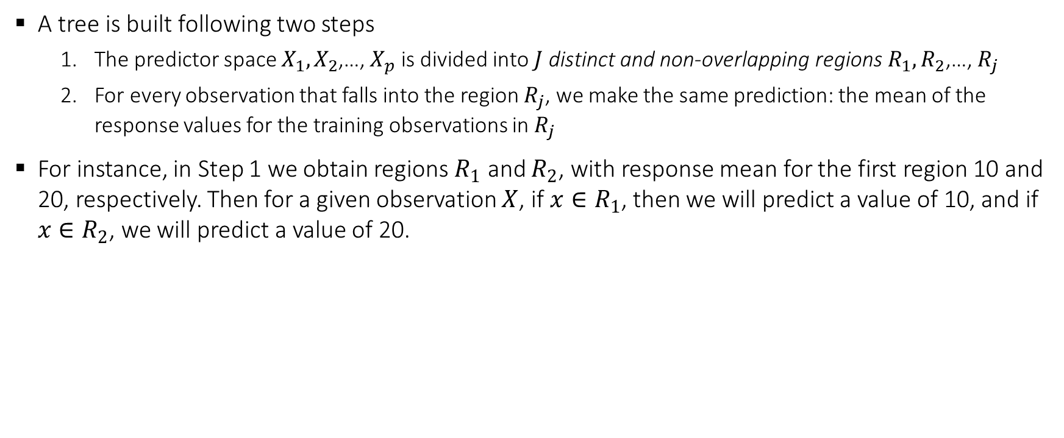
Decision Trees - Regression
A tree is built following two steps
The predictor space $X_{1},X_{2}$,…, $X_{p}$ is divided into $J$ distinct and non-overlapping regions $R_{1},R_{2}$,…, $R_{j}$
For every observation that falls into the region $R_{j}$, we make the same prediction: the mean of the response values for the training observations in $R_{j}$
For instance, in Step 1 we obtain regions $R_{1}$ and $R_{2}$, with response mean for the first region 10 and 20, respectively. Then for a given observation $X$, if $x∈R_{1}$, then we will predict a value of 10, and if $x∈R_{2}$, we will predict a value of 20.
Master in Quantitative Economic Analysis MQuEA
Universidad Autónoma de Madrid

Slide 6
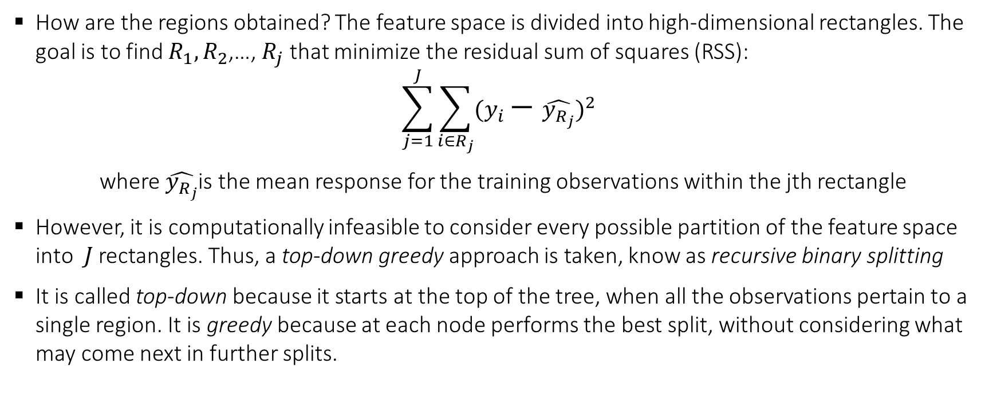
Decision Trees - Regression
How are the regions obtained? The feature space is divided into high-dimensional rectangles. The goal is to find $R_{1},R_{2}$,…, $R_{j}$ that minimize the residual sum of squares (RSS):
$$\sum_{j=1}^{J}{\sum_{i∈R_{j}}{{(y_{i}−\hat{y_{R_{j}}})}^{2}}}$$
where $\hat{y_{R_{j}}}$is the mean response for the training observations within the jth rectangle
However, it is computationally infeasible to consider every possible partition of the feature space into $J$ rectangles. Thus, a top-down greedy approach is taken, know as recursive binary splitting
It is called top-down because it starts at the top of the tree, when all the observations pertain to a single region. It is greedy because at each node performs the best split, without considering what may come next in further splits.
Master in Quantitative Economic Analysis MQuEA
Universidad Autónoma de Madrid

Slide 7
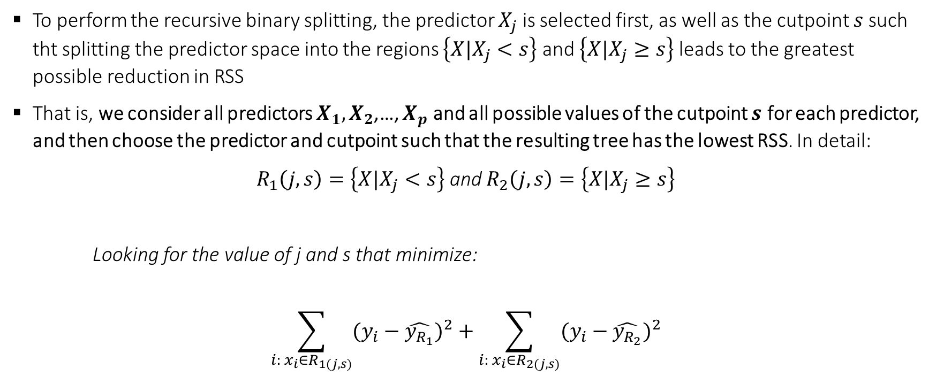
Decision Trees
To perform the recursive binary splitting, the predictor $X_{j}$ is selected first, as well as the cutpoint $s$ such tht splitting the predictor space into the regions $\left\{X|X_{j}<s\right\}$ and $\left\{X|X_{j}≥s\right\}$ leads to the greatest possible reduction in RSS
That is, we consider all predictors $X_{1},X_{2}$,…, $X_{p}$ and all possible values of the cutpoint $s$ for each predictor, and then choose the predictor and cutpoint such that the resulting tree has the lowest RSS. In detail:
$R_{1}\left(j,s\right)=\left\{X|X_{j}<s\right\}$ and $R_{2}\left(j,s\right)=\left\{X|X_{j}≥s\right\}$
Looking for the value of j and s that minimize:
$$\sum_{i: x_{i}∈R_{1(j,s)}}{{(y_{i}−\hat{y_{R_{1}}})}^{2}}+\sum_{i: x_{i}∈R_{2(j,s)}}{{(y_{i}−\hat{y_{R_{2}}})}^{2}}$$
Master in Quantitative Economic Analysis MQuEA
Universidad Autónoma de Madrid

Slide 8
Decision Trees - Regression
Next, we repeat the process looking for the best predictor and cutpoint in order to split the data further so as to minimize the RSS within each of the resulting regions.
Now that we have three regions, we look to split one of them the further as to minimize RSS….
The process continues until a stopping criterion is reached, for instance, that a region contains less than 5 observations.
Master in Quantitative Economic Analysis MQuEA
Universidad Autónoma de Madrid

Slide 9
Decision Trees - Regression
In reality, this procedure produces very complex trees that tend to overfit the data
Since simpler ones can generalize better (incurring in some bias, though), a process named pruning is carried out
By pruning a tree some branches are removed, helping in achieving a reasonable accuracy without overfiting. K-fold cross validation is involved in the process of pruning a tree
unpruned tree
Master in Quantitative Economic Analysis MQuEA
Universidad Autónoma de Madrid

Slide 10
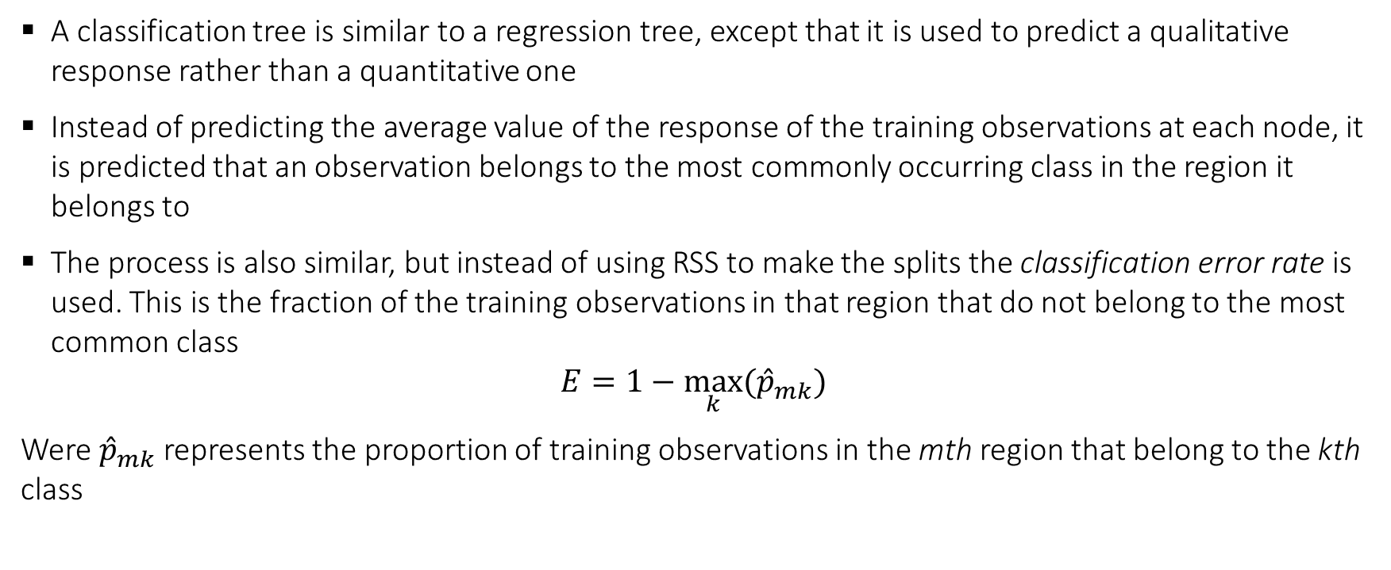
Decision Trees - Classification
A classification tree is similar to a regression tree, except that it is used to predict a qualitative response rather than a quantitative one
Instead of predicting the average value of the response of the training observations at each node, it is predicted that an observation belongs to the most commonly occurring class in the region it belongs to
The process is also similar, but instead of using RSS to make the splits the classification error rate is used. This is the fraction of the training observations in that region that do not belong to the most common class
$$E=1−\max_{k}{{(\hat{p}}_{mk})}$$
Were ${\hat{p}}_{mk}$ represents the proportion of training observations in the mth region that belong to the kth class
Master in Quantitative Economic Analysis MQuEA
Universidad Autónoma de Madrid

Slide 11

Decision Trees - Classification
However, classification error is not sufficiently sensitive for tree-growing, and in practice Gini index is used, a measure of total variance across the K classes:
$$G=\sum_{k=1}^{K}{{\hat{p}}_{mk}}(1−{\hat{p}}_{mk})$$
An alternative to the Gini Index is entropy:
$$D=−\sum_{k=1}^{K}{{\hat{p}}_{mk}}log{(\hat{p}}_{mk})$$
Master in Quantitative Economic Analysis MQuEA
Universidad Autónoma de Madrid

Slide 12
Decision Trees - Classification
unpruned
pruned
Master in Quantitative Economic Analysis MQuEA
Universidad Autónoma de Madrid

Slide 13
Decision Trees Vs Linear models
Best model depends on the problem at hand
Trees are easy to explain
Trees might be closer to human decision-making process
Trees can be displayed graphically and be easy of interpret
Trees can easily handle qualitative features without dummyfying
However…
Trees do not have the same level of prediction accuracy as other methods
Trees are not robust
Master in Quantitative Economic Analysis MQuEA
Universidad Autónoma de Madrid

